Slide 1

ON-SCREEN PAINTING
By -
YUVRAJ CHAVAN : 19N35A0524 SJB MAHESHWARAN : 18N31A05K9 FEROZE KHAN : 17N31A0562
Under the esteemed guidance of
S.Sowmya
Assistant Professor
MRCET
A Mmajor Project Report Submitted In partial fulfillment of the requirements for the award of the degree of Bachelor of Technology in
Computer Science and Engineering
Department of Computer Science and Engineering
Malla Reddy College of Engineering & Technology
(Autonomous Institution- UGC, Govt. of India)
(Affiliated to JNTUH, Hyderabad, Approved by AICTE, NBA & NAAC with ‘A’ Grade)
Maisammaguda, Kompally, Dhulapally, Secunderabad – 500100 website: www.mrcet.ac.in 2020-2021

Slide 2
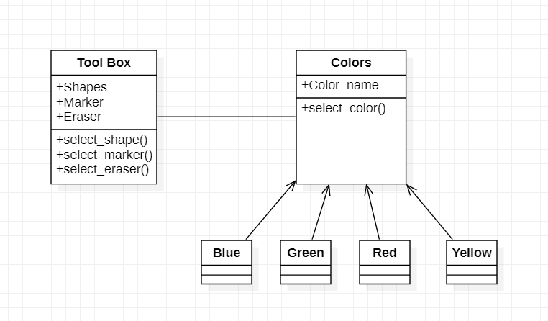
UML DIAGRAMS – CLASS DIAGRAM

Slide 3
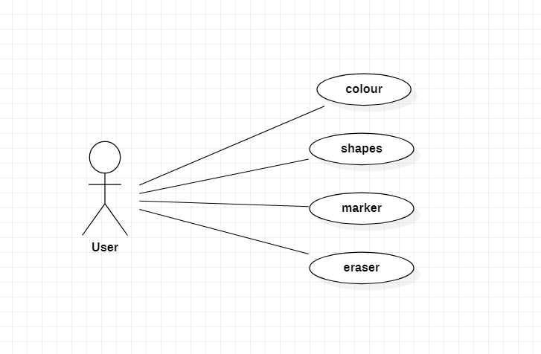
USE CASE DIAGRAM

Slide 4
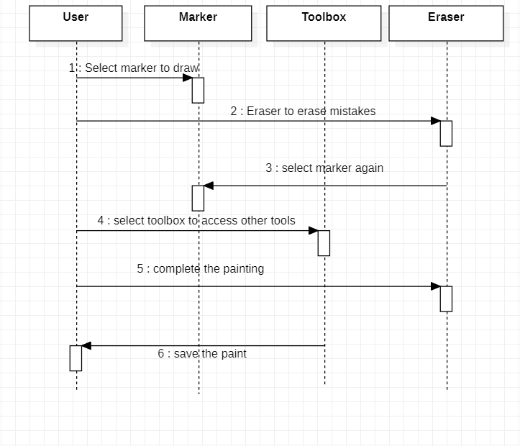
SEQUENCE DIAGRAM

Slide 5
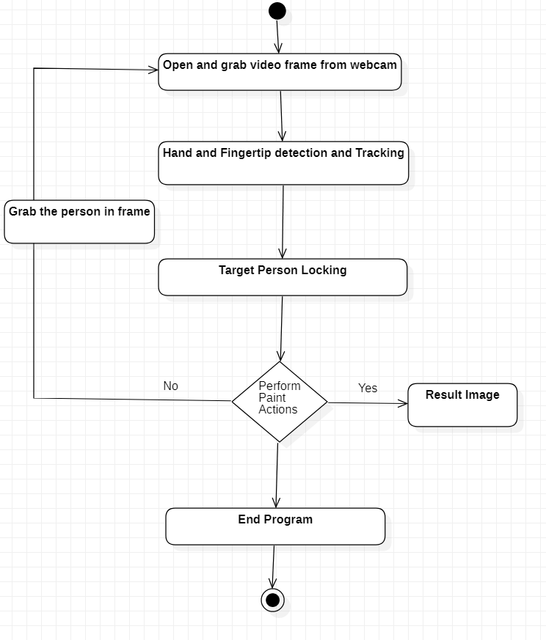
ACTIVITY DIAGRAM

Slide 6
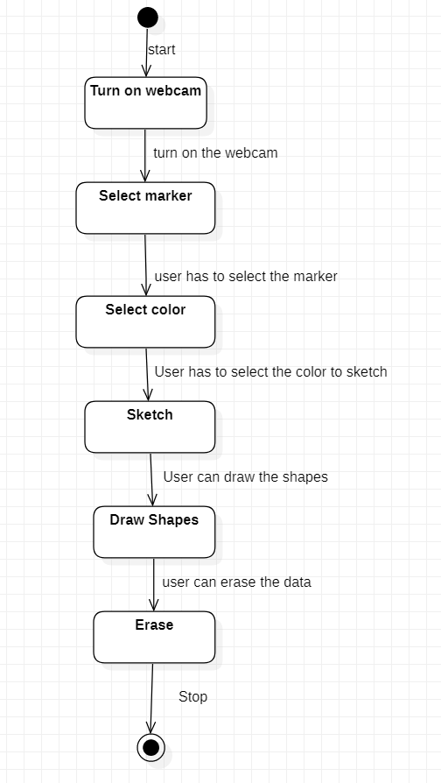
STATE CHART DIAGRAM

Slide 7
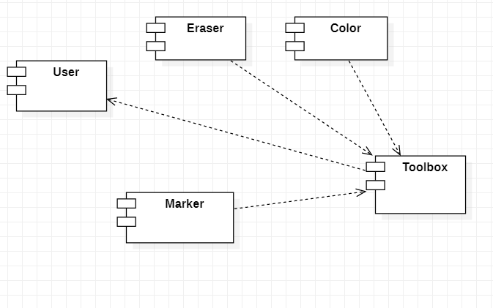
COMPONENT DIAGRAM

Slide 8
THANK YOU

